Slide 1
Anticipating Market Reactions to Fed Policy
Using NLP to forecast Currency Returns from FOMC Statements
Ben Rounds

Slide 2
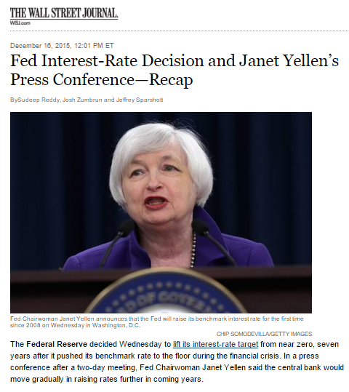
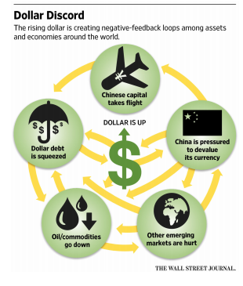
The question
“Buy the rumor, sell the news”
Can natural language processing on Fed policy statements reveal insights
Process
Seek to distill individual statements (8/year) into aggregate sentiment values by word count
Test aggregate counts of various sentiment-laden words to forecast returns to US dollar

Slide 3

The data – A tale of two datasets
Fed policy statements
Policy statements are tokenized and matched to a dictionary of financial words and corresponding sentiment scores
Currency returns and volatility
Currency returns observed over 1 day, 1week, and 1 month
Volatility is 1-month rolling
Finance words

Slide 4
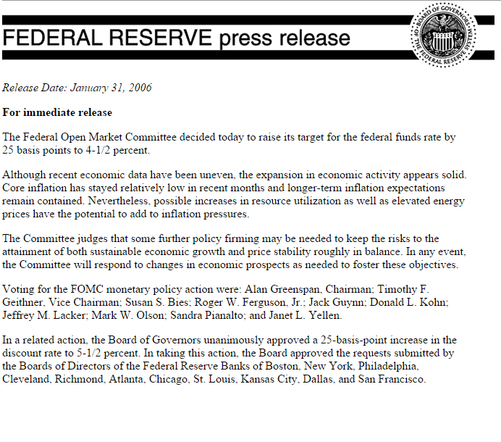

Text Matching – a closer look
Search for and aggregate words in dictionary:
1
+
+

Slide 5
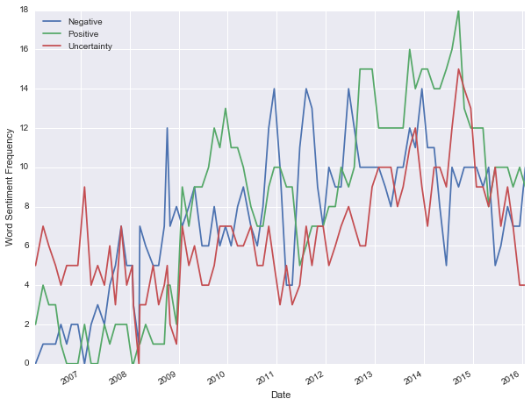
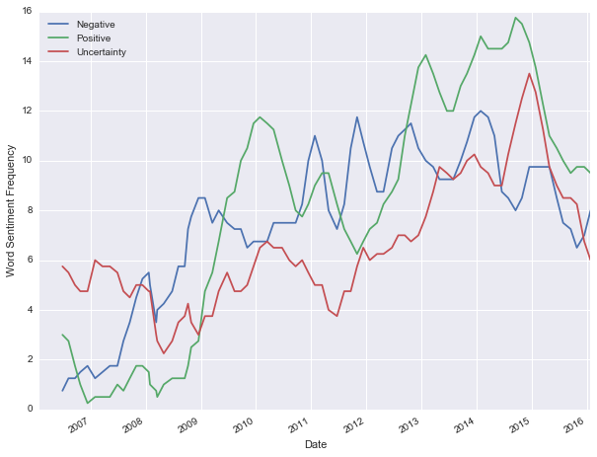
Aggregating word occurrence
Raw word occurrence overtime
Smoothed word occurrence over time
4 statement (~6 month)
rolling average of word occurrence for three possible sentiments

Slide 6
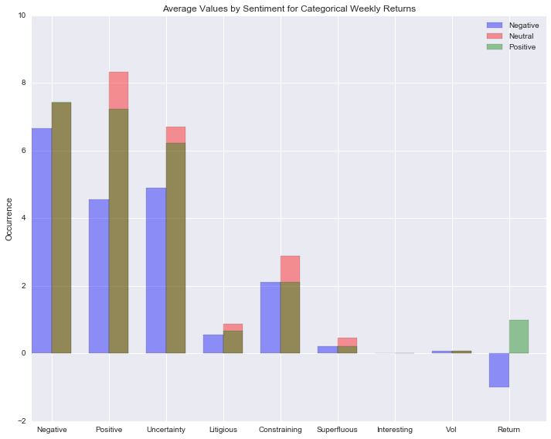
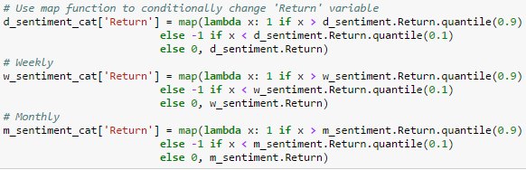
Return categorization
Returns are transformed from continuous variables into categorical based on the 10th and 90th percentile

Slide 7
Modeling
Which models were employed:
Nearest neighbors
Why?
Explainability
Relevance
Logistic regression
Why?
Explainability
Relevance
Random Forest
Why?
Ability to handle correlated features
Significance scores for predictions made

Slide 8
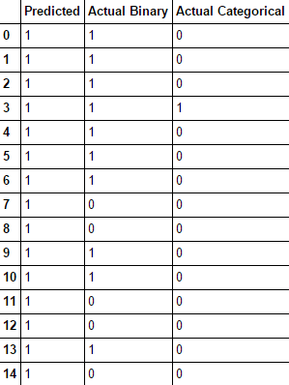
Results
No model was able to consistently predict – using any measure of success – currency returns better than the dummy regressor predicting the most common outcome
Likely a result of little differentiation in word occurrence between return outcomes as well as the categorization of returns
Exceptional return outcomes were concentrated in the beginning of the period tests (training data) while word counts have increased in the common era; need to find a way to periodically normalize to remove this effect

Slide 9
Conclusions
After fitting various models under different parameters, I've been unable to consistently form a better prediction than any naive estimator predicting the most common prediction class. This may be for any of a host of reasons, such as:
Arbitrary classification of returns into top and bottom decile versus middle
Limited data to FOMC policy statements with a particular html format
Sentiment data as measured by the utilized dictionary and/or the FOMC statements may simply not be a strong predictor of returns

Slide 10
Possible Extensions
Given more time, I would like to extend the project by:
Using a diverse array of potential return categorizations
Standardize the predictor variables by de-meaning word occurrence and volatility/sentiment
Expand the dataset by scraping more Fed statements
Add additional macroeconomic indicators (potentially something in the realm of "now-casting" using Twitter data)
Incorporate time series validation

